Slide 1

Vanguard Data Analysis
By Alex Lopez

Slide 2

Introduction
Showcasing results for the new web platform design, made with the intention of providing:
more intuitive UI,
timely in context prompts
Goal : See if New Design did help our Clients.

Slide 3
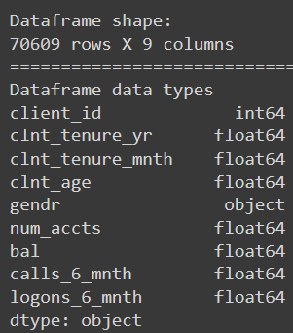
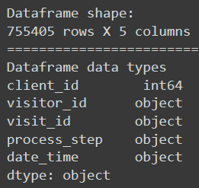
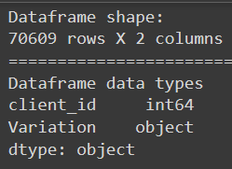
Data Overview
A/B Experiment Data was split into three key parts:
Client Profiles (df_final_demo.txt)
Digital Footprints (df_final_web_data pts ½)
Experiment Roster (df_final_experiments_clients)

Slide 4
Overview : Data Cleaning
Created function to handle cleaning.
Dropped rows with more than 80% NAN values
Final Demo:
Filled nans with U and Put remaining X in U
Client Tenure - divide tenure months by 12
Final Web Data
Datetime column formatted
Also made option to store cleaned data into csv.

Slide 5


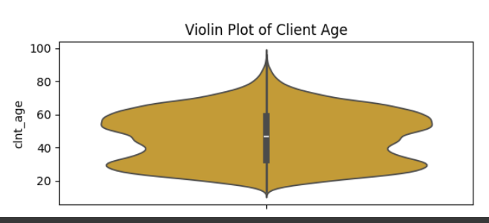
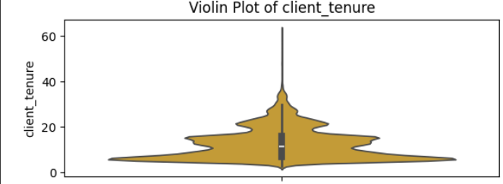
EDA
It seems their primary clients are those who :
are middle aged (45-59 years old),
clients who have had Vanguard services for around 6 to 10 years.

Slide 6
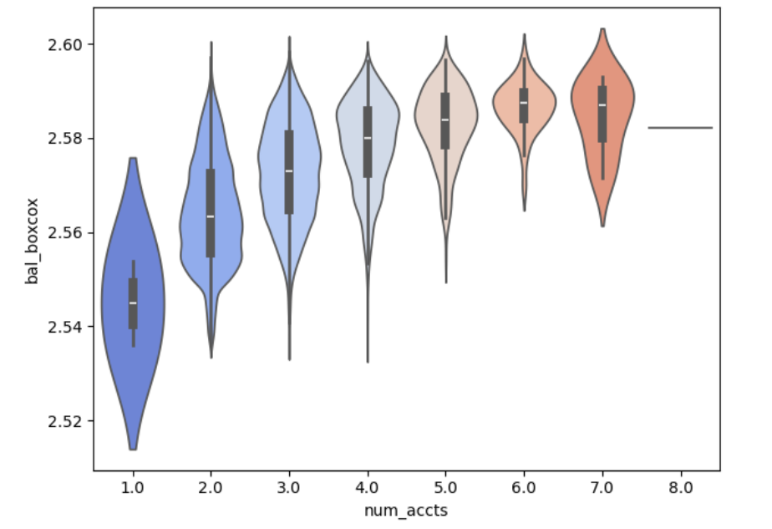
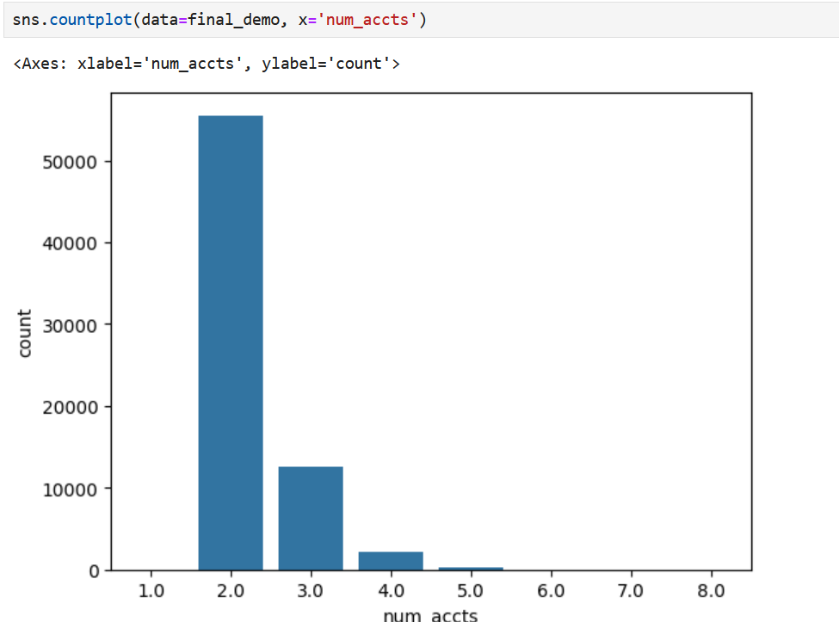
EDA: Client Behavior

Slide 7
KPI Metrics
KPI Metrics that were chosen:
Completion rate:
% of clients who successfully reached the confirm stage
Average duration of steps:
Calculated for only steps not made in error.
Error rate:
Any time User went back to a step or somehow skipped steps

Slide 8
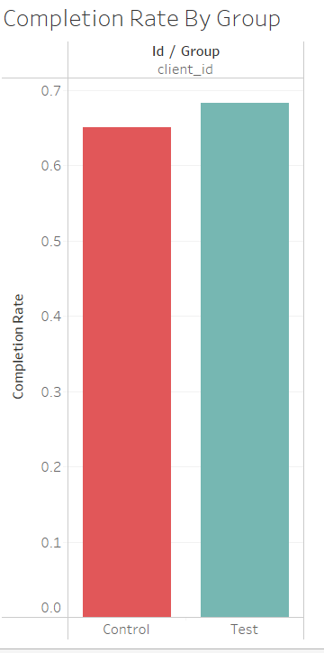
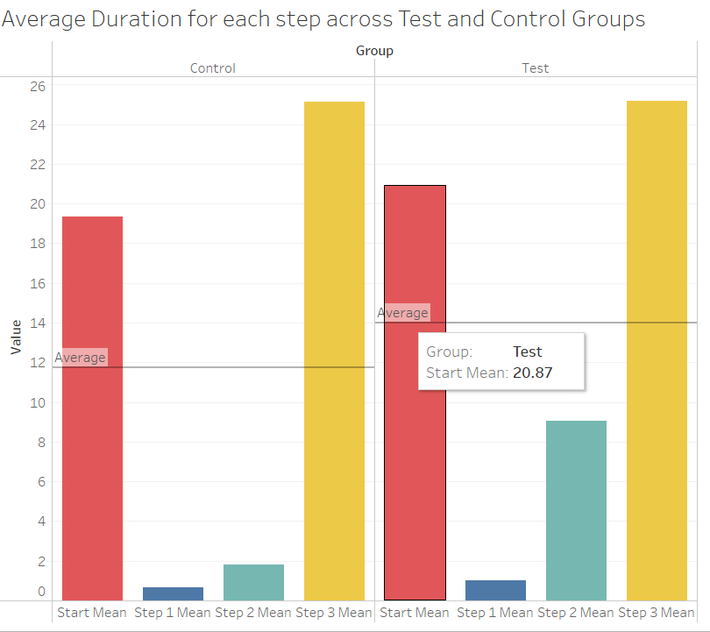
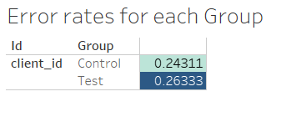
KPI Metrics Visuals

Slide 9
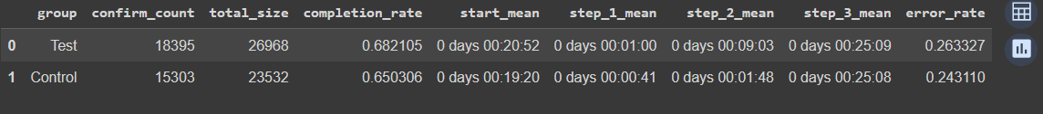
KPI Metrics
Completion rate :
test group had slightly higher completion rate at 68.0% compared to control at 64.6%.
Step duration avgs:
across the board, the test group on average had taken more time on each step than the control group. particularly in step 2
Error rate:
The error rate was slightly higher with the test group than the test group
overall, while more of the test group completed the experiment, they took longer on average per step and had more errors than the control group

Slide 10
Hypothesis Testing
Threshold for All Tests: 5%
Completion Rating: Two Sample, Tested for Test > Control.
Completion Rating w/ Cost Threshold:
Proportions Z Test One sided (test > control)
Client Age : Two sample (Test = Control)
Client Tenure: Two sample ( Test = Control)
Balance : Two Sample (Test = Control)
Gender: ANOVA Test, for
Client age
Client Tenure

Slide 11
Hypothesis Test Results
Completion rating: There was evidence that test group had statistically larger completion rate than control, but not when accounting for cost threshold.
average client age: there was statistical evidence to support the client ages across the groups were different.
average client tenure(transformed by sqrt): Client tenure seems consistent across both test and control groups.
balance (boxcox) - balances seem consistent across test/client groups.
difference across gender: Through the ANOVA test, we found that:
- There was significant differences in both the test and control groups for client age
- There was significant difference in both test and control groups for client tenure

Slide 12
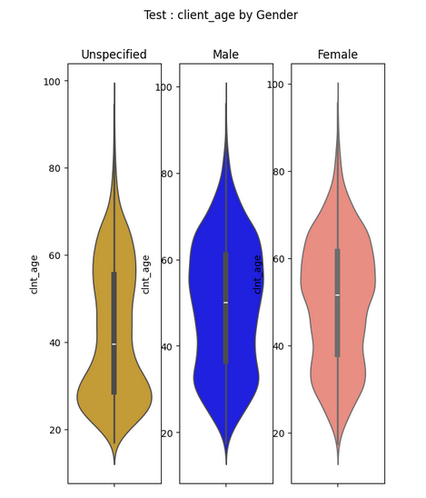
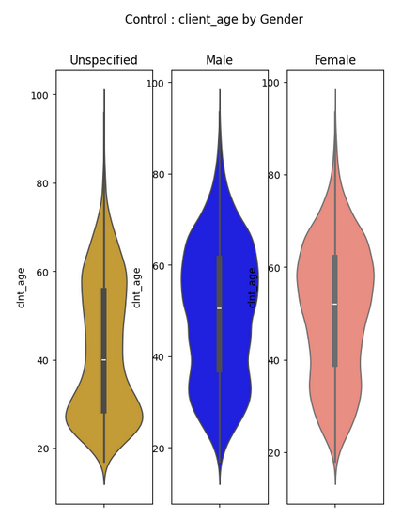
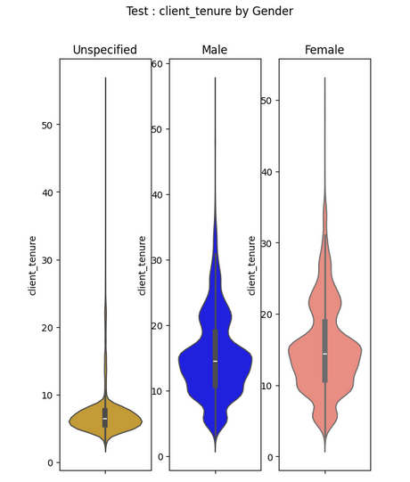
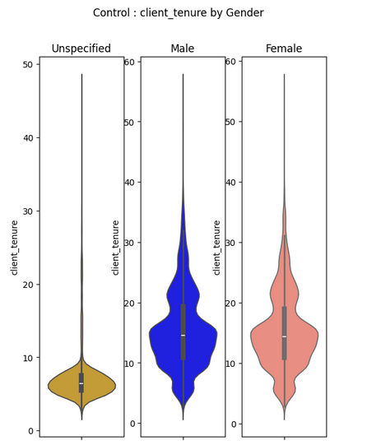
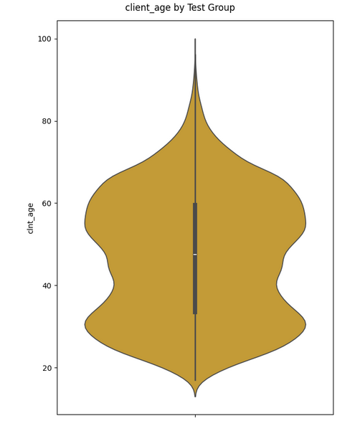
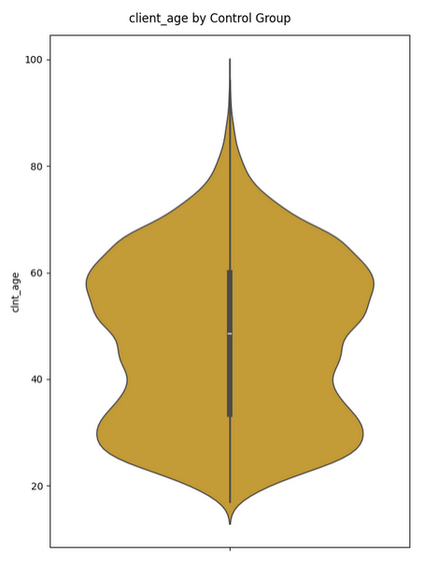
Some Visuals for Hyp Test/Eval

Slide 13
Experiment Evaluation
Issues with Experiment Structure:
Slight bias in client age between test and control groups:
Presence of more younger in late 20s-Early 30s in Test Group
Significant differences across gender for both client age and client tenure, this probably made more of an impact.
Duration assessment (March 15 2017 - June 20 2017) was Sufficient:
participation rate in experiment 71%, good portion of customer base
66% of participants logged each step at least once.
Additional Data Needs:
More context on what was different between the old design and the new design
More context on how Users Interacted with Website

Slide 14
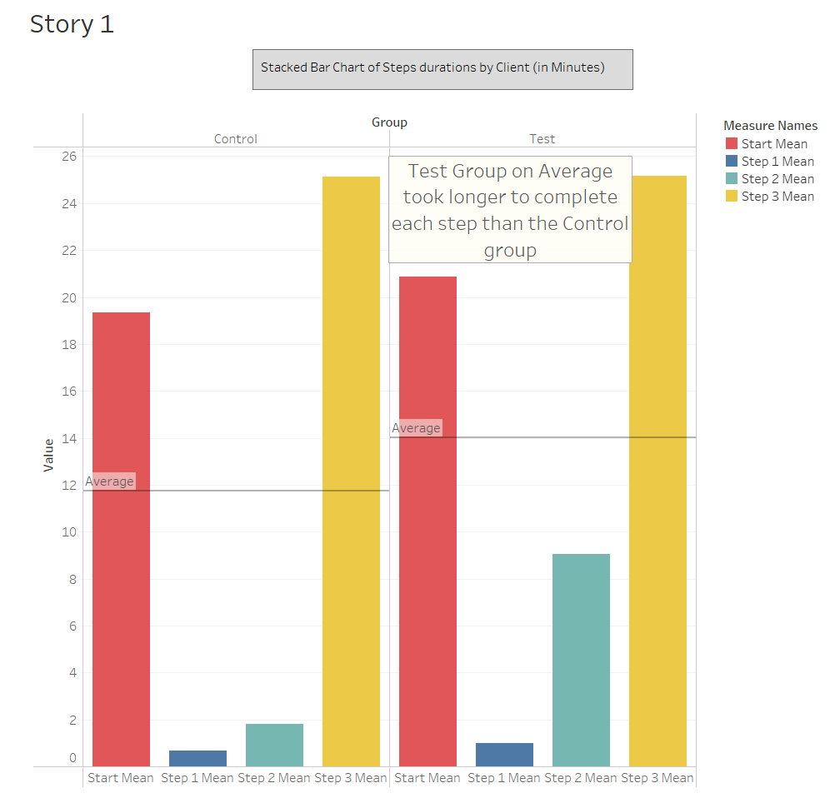
Tableau Story

Slide 15
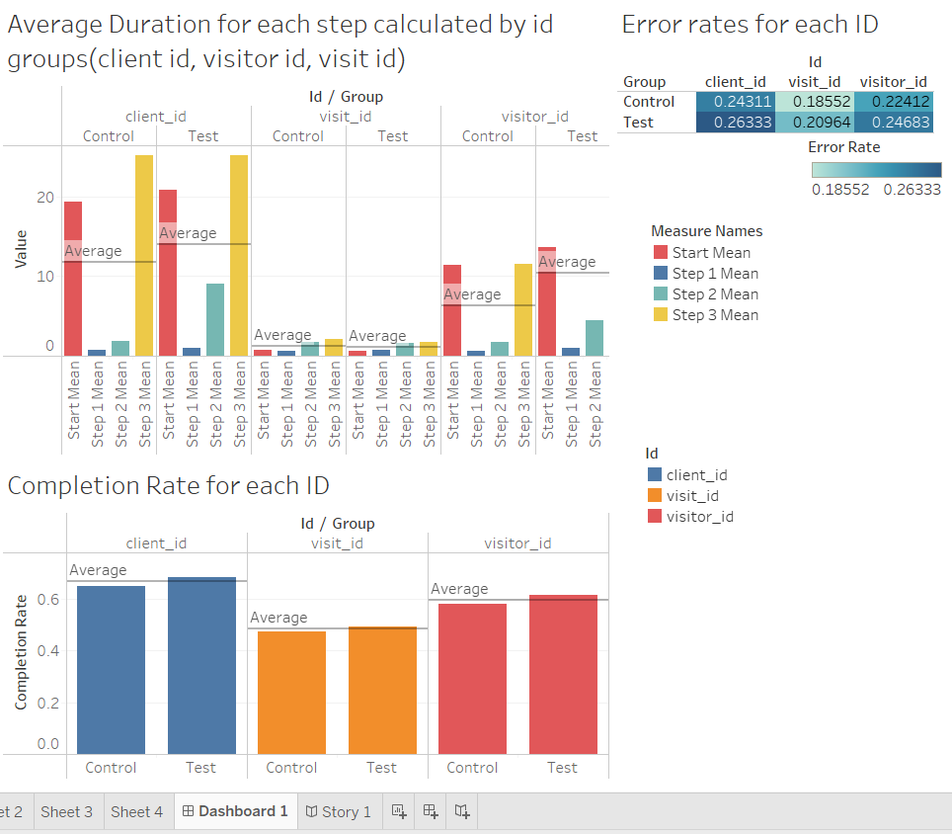
Tableau : Dashboard

Slide 16
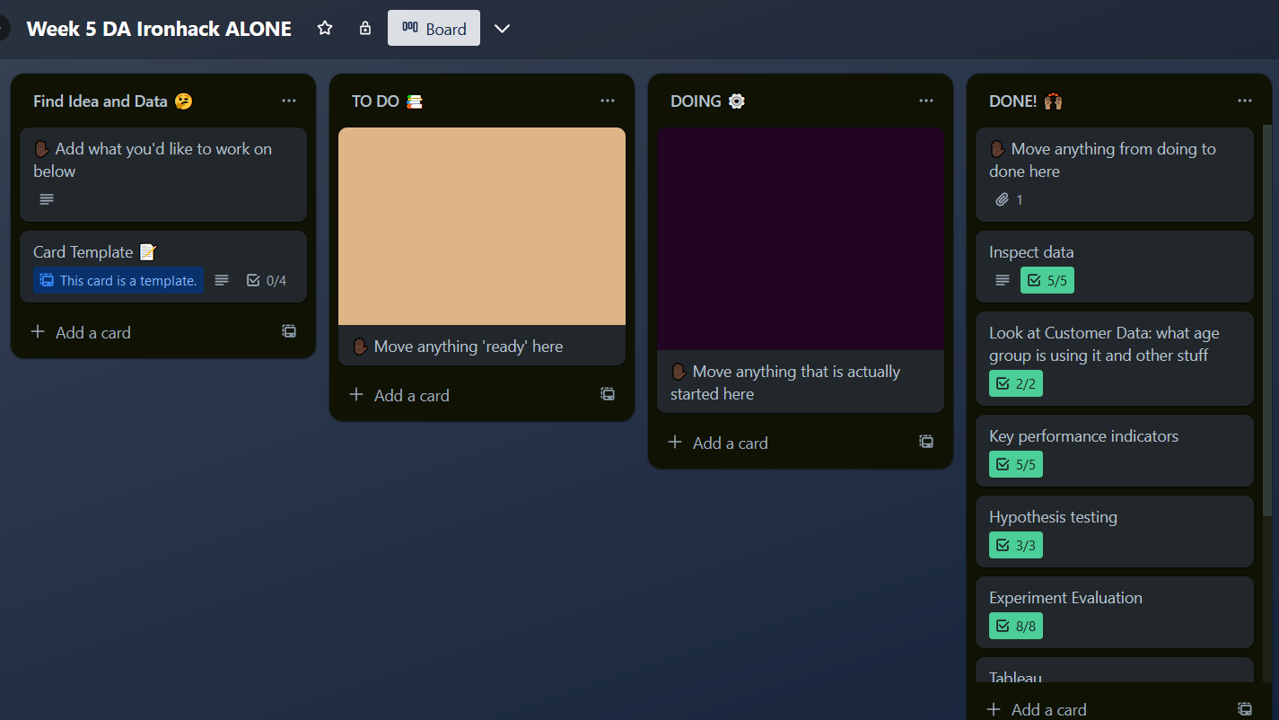
Project Management
What board Did I use: Trello
Used it to guide my Progress/Keep track

Slide 17
Difficulties/ What I learned
Not having a partner to share workload/share ideas
Spending way too much time trying to optimize code for kpis
Struggled with Focus/staying on task
Struggled to understand Bi-variate analysis and How to utilize it
Used Trello Board to Track Progress
Focused On what I needed and getting info on how to get it
Be patient with myself

Slide 18
CONCLUSIONS
Completion Rate :
Significant Increase from the new design, but not enough to justify it (less than 5 % increase)
Also spotted issues with splitting between control and test groups
Differences in age, Gender demographics
More context on interactions between designs
Click rate, form interaction rate, device info, etc.
Recommendation : Redo experiment, take account for issues, get customer feedback

Slide 19

Thank you for your time

